Slide 1
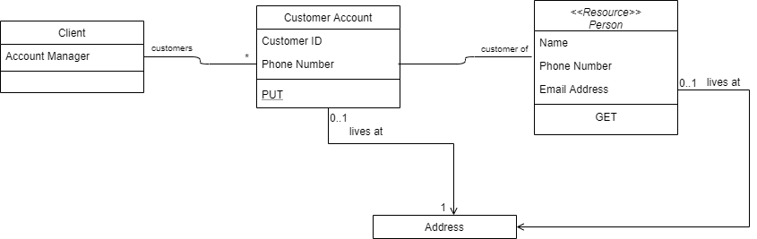
Straw man for Client/Customer Relationship

Slide 2
Slide 3 Key Points
All new Client/Customer orders are created thru one of these flows:
Client’s Integrated Cart to OnTech/Shopify
Directly into OnTech/Shopify
Client/Customer Portal Order Entry UI
Standard API’s
A new Clients can be setup to deliver new orders thru any one or many of the options in 1 above
All orders from either the Client/Customer Portal or Ontech flow thru Order Management, DOMO FEP and then DOMO before flowing to OFS
Client Portal allows for Client personnel to view Customer and order data over time with various metrics
Client Portal allows for Dish personnel to view Client, Customer and order data over time with various metrics
All Clients setup prior to JMP go-live, with orders coming thru OnTech, when setup in the Configuration and Client Portal, will have data viewable in the Client Portal like new Clients
A one-time order data load to the Order Management system for past orders may be necessary
All dotted line flows are current and expected to be removed as part of the scope of this project
Appliance Repair Clients (Partners) will need to be re-routed away from direct load to WFM and to Client Portal APIs to Order Management instead
Client users will be routed to OnTech to enter a new order instead of using the JMP Order Entry UI if the client was setup in the Config Portal to require payment on order submission

Slide 3

Customer
B2C-IAM
Ping?
B2E-IAM
Okta
IHS / Command Center
Shopify
Product
Catalog
Integrated Cart
JMP Delivery Scope
Client website
Client Configuration Portal UI
Customer
Master
{ }
Internet Facing
Config
Client/Cust Portal
Client
Order Entry UI
Client
OnTech / Shopify
Customer
OnTech/ Shopify-EP
Standard APIs
CIB-Transform-EP
Handy order
DOMO
Edge
CIB-Correlate-EP
Other-EP ...
DOMO
Handy
OFS
Add SPs and order status logic ?
Appointment SP
Order
WFM
Capacity check
Create work order #
WIP - Component Diagram - last updated 4/10/2020
Notes:
This builds on Darren’s updates and mostly addresses my todo items from the previous version. The key points on slide 6 should still apply.
DOMO FEP is now DOMO Edge. So the FSPs are now “EPs”, an EP (“Edge Processor”) is like an SP - it's event driven etc. But instead of going full DOMO we'd look for a more light-weight approach for the initial stages of the platform.
So:
#1 - implementation can be quick and dirty for phase 1.
#2 - it should be easy to convert an FSP to work as an SP in DOMO later.
Other changes
The Client, Customer and Order databases are now first-class components representing separate microservices. DOMO Edge is a direct consumer of the Order service, but does not directly depend on Client and Customer
I’ve added:
The Customer Master - primary source for Dish Customer IDs - no further integration planned at this point
The OnTech Product Catalog, which is a replicant of the Shopify catalog. Working assumption is we integrate with it rather than building a catalog service.

Slide 4
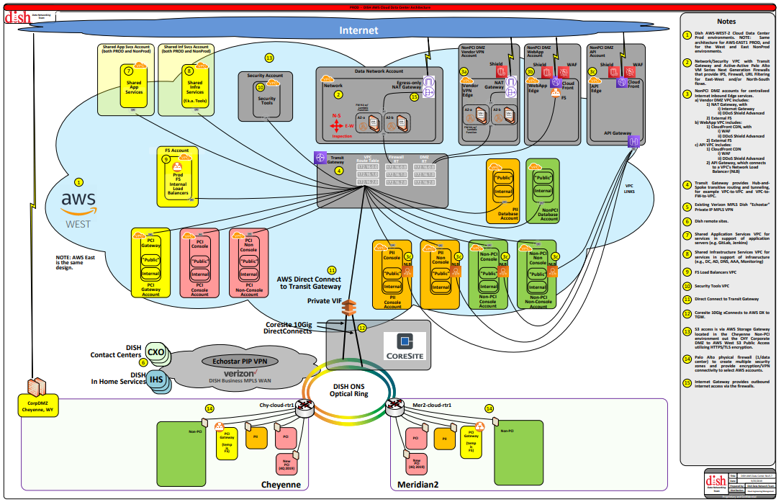
DC: copying this here for easy reference
Notes:
Things to note:
Support for inter-VPC routing and Internal Direct Connect between On-Prem, AWS
Separate accounts and patterns for APIs, Webapp
Zones for PCI, PII, etc. with corresponding controls implied for ingress, egress.

Slide 5
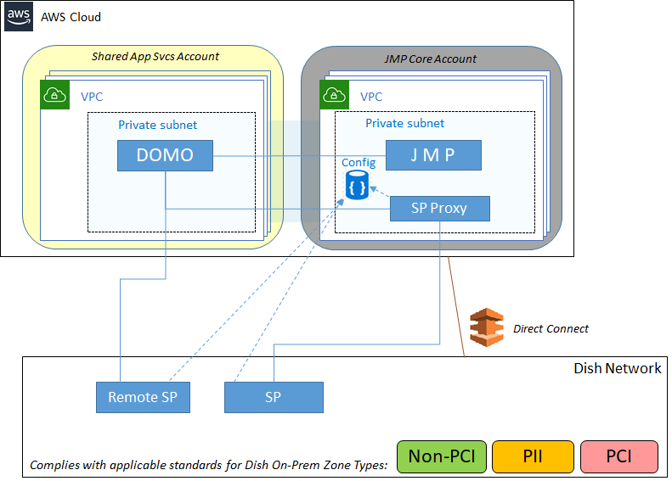
DOMO / SP Options for On-Prem Integration
Assumptions:
Cloud DOMO is shared infrastructure; JMP is one of potentially many dependent systems.
JMP operates in its own/separate AWS account / VPCs etc.
JMP Client Config will drive order processing including some SP behavior.
Notes:
This slide added as a discussion document for scoping purposes:
- Are we - JMP - migrating any on-premises functionality (e.g. WFM) to AWS?
- What on-premises components do we need to integrate with (DOMO SPs or other), and what security zones are they in (nonPCI, PCI, PII)?
- Should we assume a shared DOMO infrastructure is our project expected to deliver that?
This is a hi-level view focusing on external dependencies for JMP. We easily could show more accounts detail here. The security overview diagram (next slide) shows patterns for separate Webapp and API accounts.

Slide 6
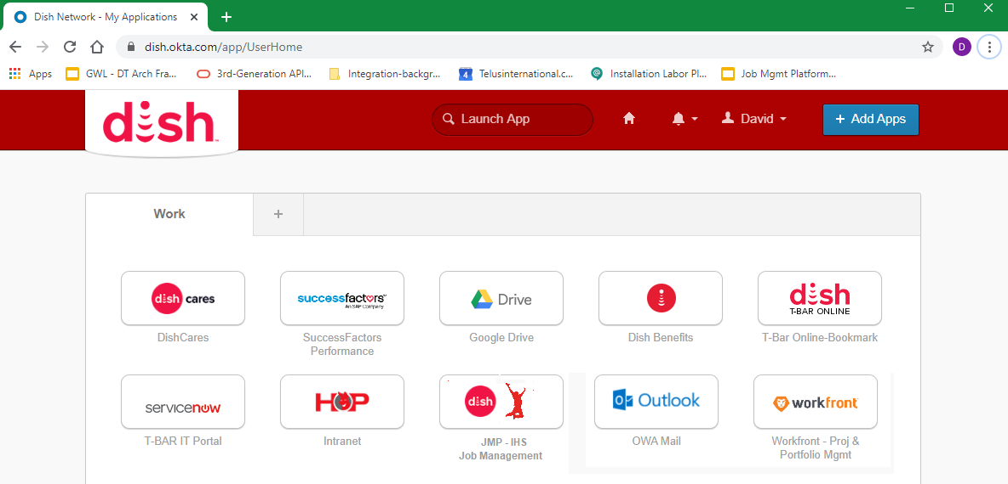
Client Config Login - working assumption
Dish Admin Login to Client Account

Slide 7
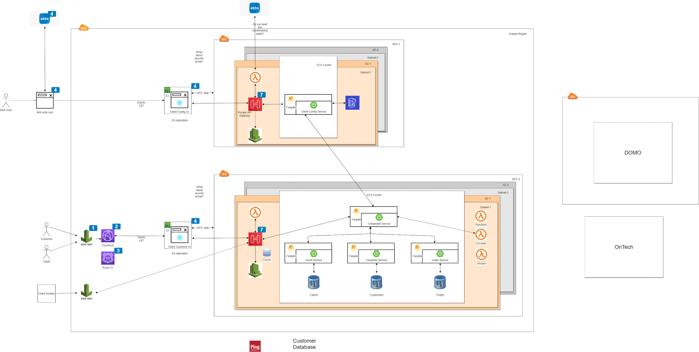
Deployment View

Slide 8
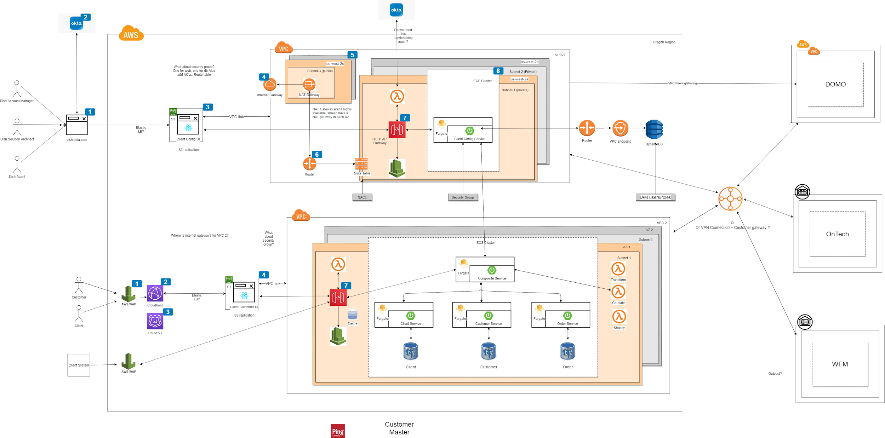
Deployment View

Slide 9
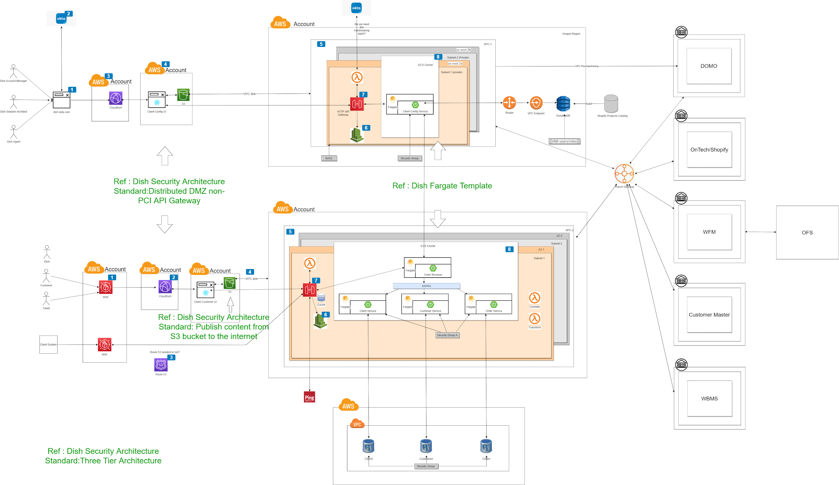
Deployment View

Slide 10
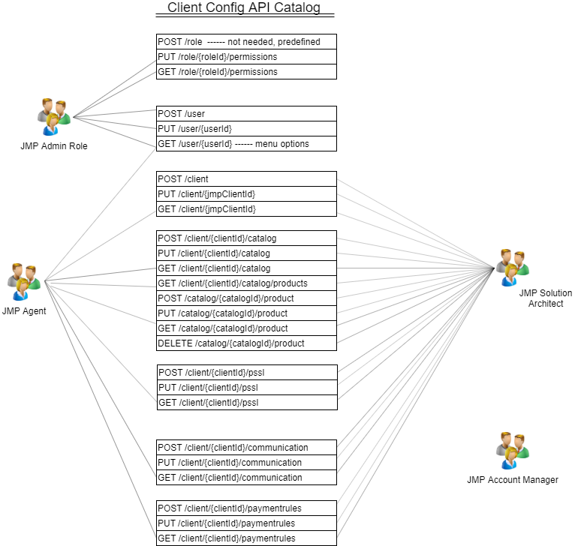
Client Config API Catalog

Slide 11
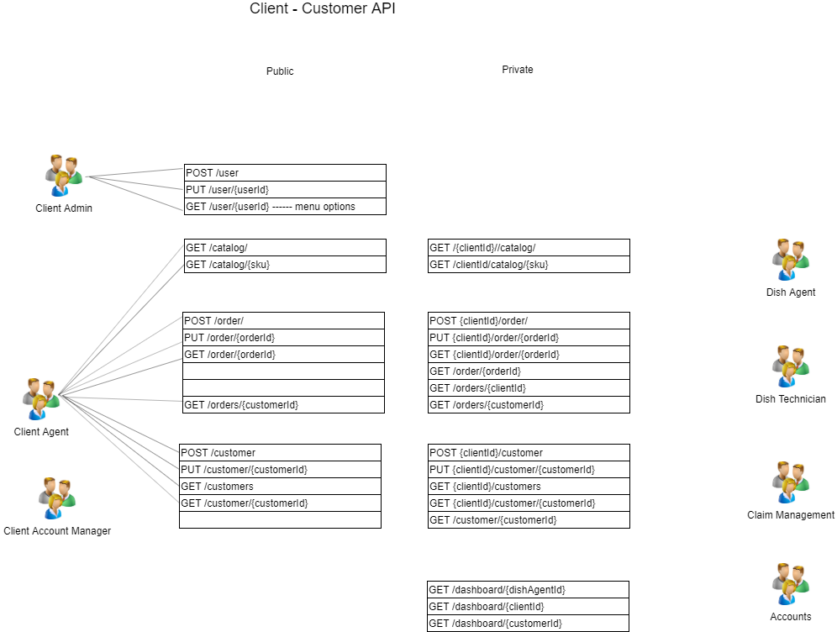
Client Customer API Catalog

Slide 12
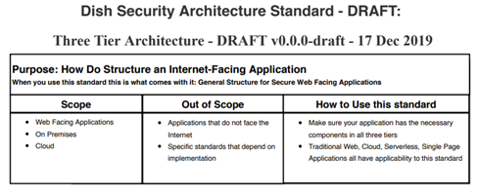
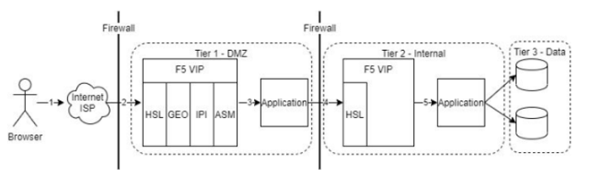
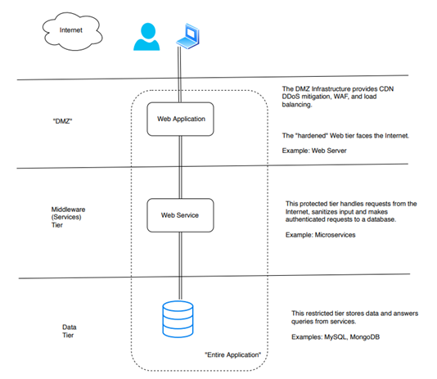
Source: Application OnBoarding Standard

Slide 13
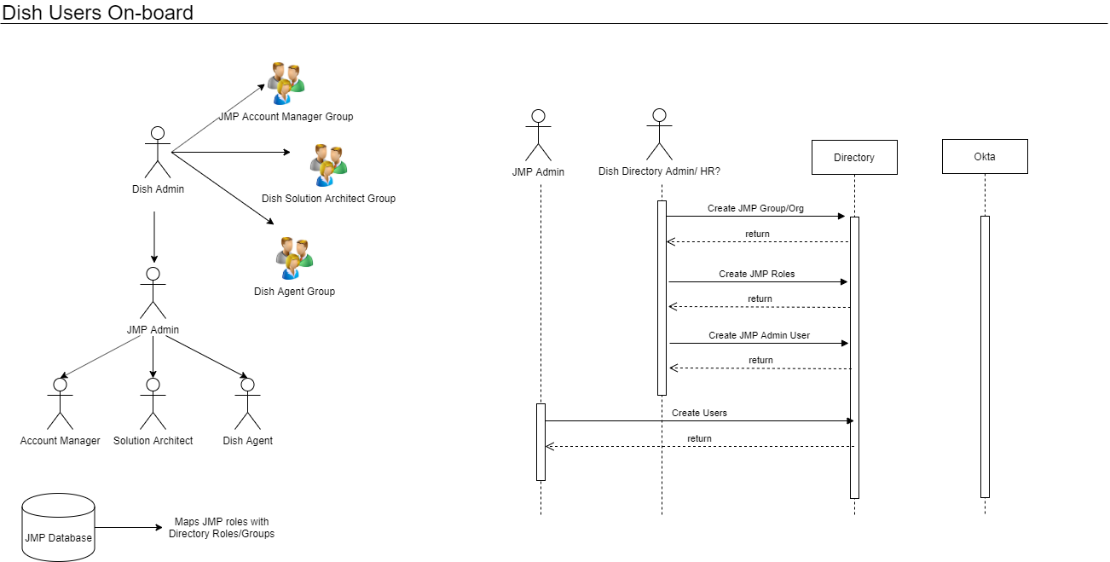

Slide 14
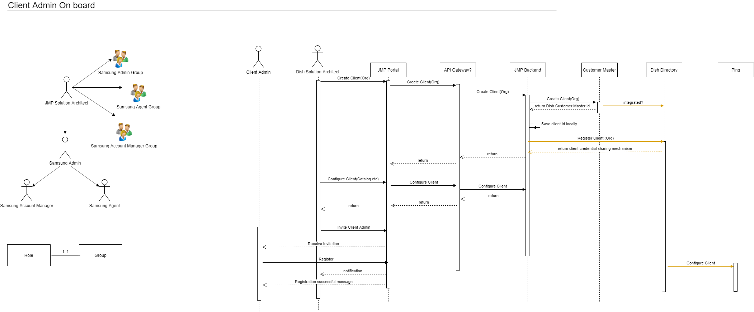

Slide 15
JMP Client - Customer - Order relationships
Client 1
Client 2
Customer Rec (JMP) - Customer X (Bill Smith)- CID 345
Client 1 - Customer X (William Smith)- CID 789
Client 2 - Customer X (William Smith)- CID 899
Client 1 - Customer X - Order 123
Client 2- Customer X - Order 234
Customer Master (Enterprise) - Customer X (Billy Smith)- CID 567
Notes:
1) Customers will come to JMP in a relationship with a client, not as an individual.
2) Upon setup by client or submission of 1st client-customer order, the following is generated:
- Client-customer record is created
- Customer master (JMP record) is created
- Customer Master (Enterprise record) is created/identified
- Client-customer-order record is created
- Customer login credentials are created
3) Client users can update attributes on the Client-customer record
4) Customers can login and update attributes of the Customer Master (JMP) record
5) Some Customer Master attributes may override Client-customer attributes on the orders - biz rules tbd
T

Slide 16
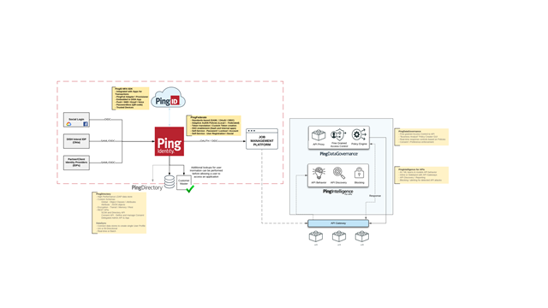

Slide 17
